Slide 1


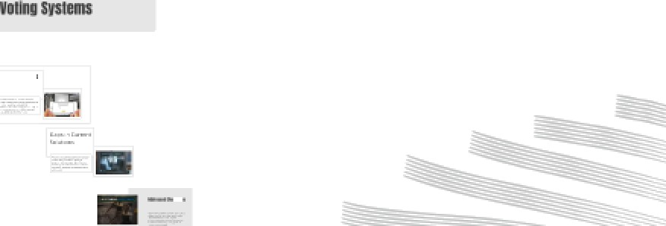




¥EBESABLEBFII4EEPEIETBASEB ELE¢TE0IIt V0TII4 MA¢£I5EF0R PRI¥ATE t0MMUElTlES
A Secure and Biometric-Authenticated
Voting System
Group Number:15
Presented by
Brijesh Nishad : 2101321550026 Ashutosh 2101321550021
Aayush Pandey 2101321550001
Under the Supervison of Mr. Rajat Kishor Varshney
(Department of CSE-IoT GNIOT Greater Noida,lndia)

Slide 2


Slide 3


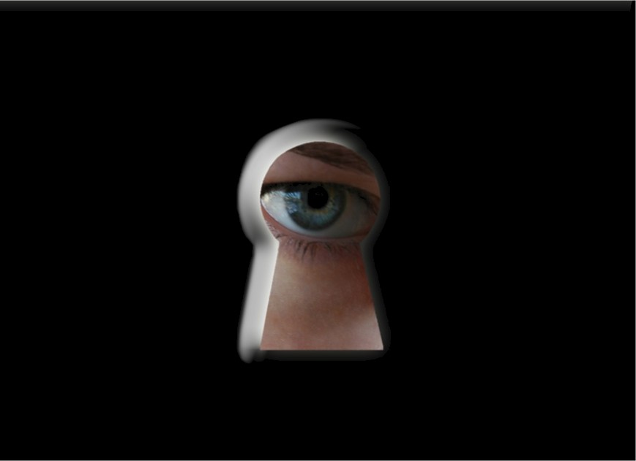
Traditional voting systems are vulnerable to fraud and impersonation, undermining democratic processes. These issues necessitate a more secure, tamper-proof alternative for voting in private communities.

Slide 4





There is an urgent requirement for a voting system that guarantees voter identity and prevents unauthorized access or tampering. The increasing reliance on technology in voting amplifies the need for foolproof systems.
WEF-EVM
Web Enabled Fingerprint EVM Private Community

Slide 5




The proposed solution combines biometric fingerprint authentication with a web-based electronic voting machine (EVM) to create a secure and ePicient voting process for private communities.

Slide 6




Key features include fingerprint verification for user authentication, a reai- time results web dashboard, and the speciaiized ESP32 hardware for efficient offline fingerprint processing.
Key Features
ur fingerprint-based Evl i system provides unparalleled security and convenlence
Biometric Authentication
secure voter identification through fingerprint verification
Tamper-Proof Design
Mllltory-grade encryption ond blockchoin technology make the
Real-Time Results
Get instant voting result with our cloud-Dosecl system that updates in
Web Enabled
from onv device.

Slide 7
¥EBESABLEBFII4EEPEIETBASEB ELE¢TE0IIt V0TII4 MA¢£I5EF0R PRI¥ATE t0MMUElTlES
A Secure and Biometric-Authenticated
Voting System
Group Number:15
Presented by
Brijesh Nishad : 2101321550026 Ashutosh 2101321550021
Aayush Pandey 2101321550001
Under the Supervison of Mr. Rajat Kishor Varshney
(Department of CSE-IoT GNIOT Greater Noida,lndia)

Slide 8
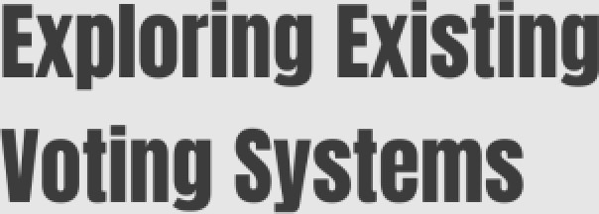



Gaps in Current Solutions

Slide 9

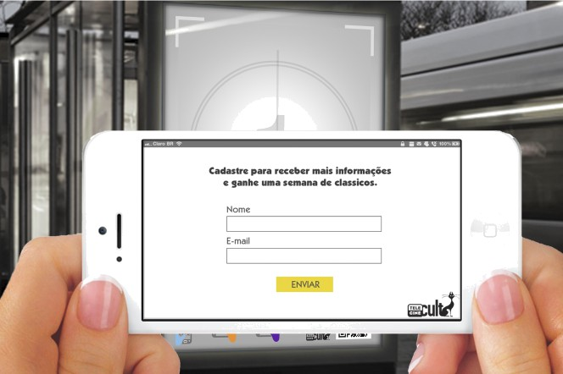
EXïStïhg 3ÿSt9MS
Traditional EVMs in countries like India utilize hardware solutions without biometric checks, exposing vulnerabilities.
Additionally, online voting platforms rely on password systems that are increasingly susceptible to phishing attacks.

Slide 10
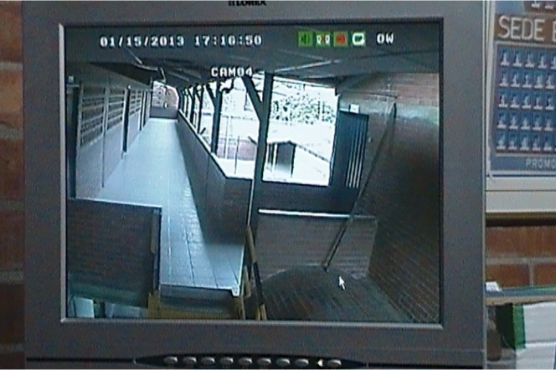
Gaps in Current
Soiutions
Most existing voting systems fail to provide unique voter verification, leading to potential duplicate votes. Hybrid systems combining web technology with hardware are scarce, resulting in limited accessibility and security.

Slide 11










Implementing biometric authentication, such as fingerprint verification, helps to significantly reduce impersonation risks. A hybrid architecture optimizes both security and user accessibility, addressing crucial gaps in the current voting landscape.

Slide 12
¥EBESABLEBFII4EEPEIETBASEB ELE¢TE0IIt V0TII4 MA¢£I5EF0R PRI¥ATE t0MMUElTlES
A Secure and Biometric-Authenticated
Voting System
Group Number:15
Presented by
Brijesh Nishad : 2101321550026 Ashutosh 2101321550021
Aayush Pandey 2101321550001
Under the Supervison of Mr. Rajat Kishor Varshney
(Department of CSE-IoT GNIOT Greater Noida,lndia)

Slide 13


Slide 14




ADMINS
crea tes
The proposed architecture integrates a web portal for user interaction with an ESP32 backend, processing fingerprint data and managing database connections. This hybrid setup ensures both security and accessibility for voting in private communities.
VOTERS
CANDIDATES
casts
receives
VOTES

Slide 15













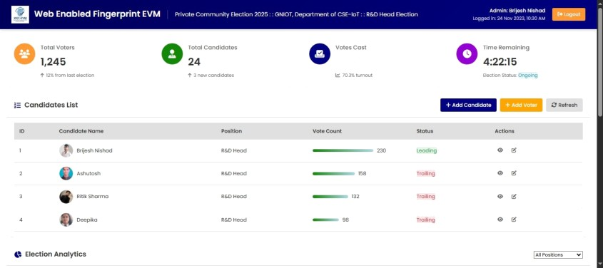
te
Ba ke etaii
The frontend consists of an admin and voter dashboard, while the backend utilizes a Spring Boot REST API for managing voter information and authentication processes.
MySQL database enhances data
management efficiency and security.
B76

Slide 16

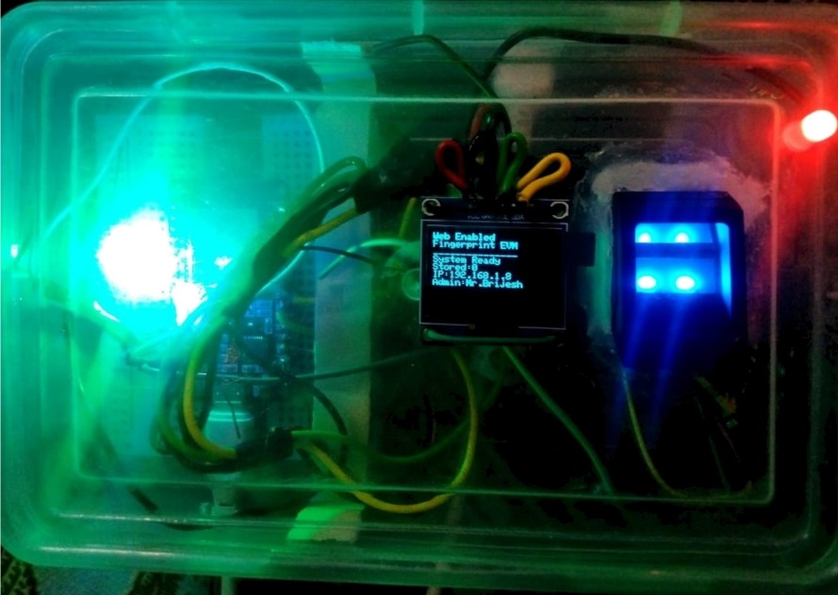
C#M§#h#htS
Key hardware components include the ESP32 microcontroller for data processing and the R307 fingerprint sensor for capturing and verifying fingerprints.
Together, they form the
backbone of biometric authentication in voting.

Slide 17



HOW it Of' S
simple tnree-step process lor secure Qno efficient voting
The voting process workflow involves admin registration of voters via fingerprint, followed by voter authentication and vote casting. This flow ensures a systematic approach to secure and reliable voting.
Voter Regictrotion
Voters register their fingerprint wirh outhorizecl personnel to create their unique voter profile.
ringerprint Authentication
On voting day, voters authenticate using their fingerprint to access the voting interface.
Select your candidate ona confirm your choice. The vote is immediately encrypted ond stored.

Slide 18

1. Database Irnplementatîon
' ER Dia granJ
The database architecture includes essential tables: Voters, Candidates, and Votes. A detailed ER diagram visualizes the relationships and data integrity essential for secure transaction handling in the voting process.

Slide 19
¥EBESABLEBFII4EEPEIETBASEB ELE¢TE0IIt V0TII4 MA¢£I5EF0R PRI¥ATE t0MMUElTlES
A Secure and Biometric-Authenticated
Voting System
Group Number:15
Presented by
Brijesh Nishad : 2101321550026 Ashutosh 2101321550021
Aayush Pandey 2101321550001
Under the Supervison of Mr. Rajat Kishor Varshney
(Department of CSE-IoT GNIOT Greater Noida,lndia)

Slide 20





























Wiring and
'"
Experiments and Results

Slide 21
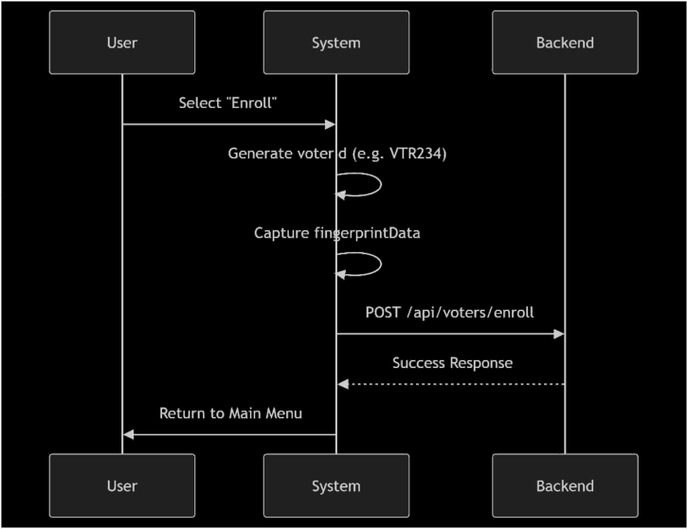
Database
Impiementation
The voting system includes critical tables: Voters, which contains IDs and fingerprint templates; Candidates with IDs and party affiliations; and Votes mapping voters to candidates. An example SQL statement creates the Voters table with fingerprint templates stored as LONGBLOB for privacy and security.

Slide 22


I RESt API Oocuwn tation
1
1 8 a se
1
ht t ps : // port a1. øe+ - e v+r . c o+r/ ap i
Aut hentic atżon
E ndpoi nt
be sc r š pł io n
POST Pa s sword - ba se d adnin login
/ adnin/ a dain - login
EhapoihlS
/ adnin/ a dmin - 1ogin bionet r ic POST Fi nger pri nŁ - ba s ed adni n a gi n
Admin Endpoi nt s
Endpoî nt
Netnod De s cr i pt ion
/ adcin/ î ogin- s uc c es s ge-t cente-r i mo GET Gel votin g c enter ipfo
Yadein/t at voters GET Get tot a 2 regs stered voters
/ adnin/tot at - c andidate s GčT Get tot a ï candidates
/ adci n/ voŁes - cas t
GET
POST Add new c andidate POSt nw vo t er
GE T Li a ï anö Daak e s Get vot ing ana Z y t i s
GčT Get ce c ent sy s eø ac t ivi ty
Cfiec k s y st ee head t h
/
n/ a dd - c andżd at e
/ adci n/ a dd- voter
7 dci n/ c andidale- 1i st
/ adøin/ ana Z ysi s GET
The system utilizes three essential API endpoints: / api/admins/add-voter for registering voters, /api/ votes/cast for submitting votes, and /api/votes/ results for fetching real-time voting results. These endpoints facilitate streamlined interactions between the frontend and the backend.
Y adain/ we c enI ac t ivity
/ adnin/ e vø- hea1t h
Vat er Endpoi nt s
besc r ’i pt io n
Ver i by
Mingerpr i nt
C andidat Endpoint s
P0St
E ndpoint
/ c andioa t e/1 i st GčT
L i sI a î
c andid a te s

Slide 23

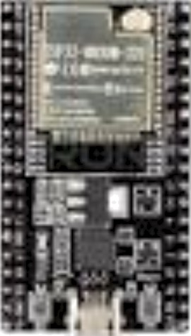
Hardware
ng and
Functionaiity
The hardware comprises an ESP32 microcontroller and an R307 fingerprint sensor. Wiring connects the VCC to 3.3V, with TX and RX routed through GPI016 and GPIO17, respectively, enabling robust fingerprint processing and server communication.

Slide 24


C#hSïÖ9FâÏï#hS
An HTTPS protocol secures communication between the ESP32 and server, while jWT tokens are used for session management.
Fingerprint templates are securely stored as LONGBLOB, ensuring they remain irretrievable, coupled with fast indexing for efficient lookup.

Slide 25

Experiments
and Resuits
Testing revealed a flawless 0% false accept/ reject rate with 100 voters, while vote casting latency remained under 2 seconds. These results emphasize the reliability and ePiciency of the biometric voting process, ensuring accurate voter identification.

Slide 26



6#h6IuSieh âhd
The web-enabled voting system presents a secure, scalable, and fraud-resistant solution for private communities. Future enhancements may include integrating facial recognition and implementing blockchain technologies to ensure even greater transparency and tamper-resistance.
WEF-EVM
Web Enabled Fingerprint EVM
Private Community

Slide 27
¥EBESABLEBFII4EEPEIETBASEB ELE¢TE0IIt V0TII4 MA¢£I5EF0R PRI¥ATE t0MMUElTlES
A Secure and Biometric-Authenticated
Voting System
Group Number:15
Presented by
Brijesh Nishad : 2101321550026 Ashutosh 2101321550021
Aayush Pandey 2101321550001
Under the Supervison of Mr. Rajat Kishor Varshney
(Department of CSE-IoT GNIOT Greater Noida,lndia)

